Slide 1

schoolpicker
Project #2 – UCSD Data Visualization Boot Camp
https://github.com/amitmals/IPEDS
Amit Malik /amitmals
Dan Rooney /13thRooney
Manu Shetty /shettman

Slide 2


Project details
Why?
IPEDS data is not easy to navigate and dumps out csv files with no visualizations
How? - Using our learning from the bootcamp:
Python Flask–powered RESTful API
HTML/CSS
JavaScript
Mongo
Leaflet
Plotly
A dashboard page with multiple charts that update from the same data

Slide 3
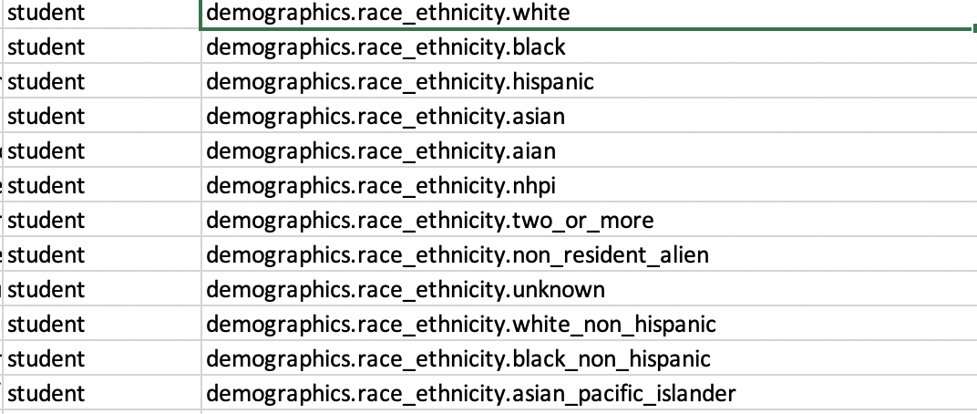
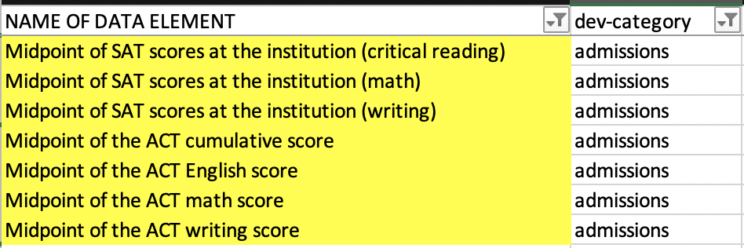
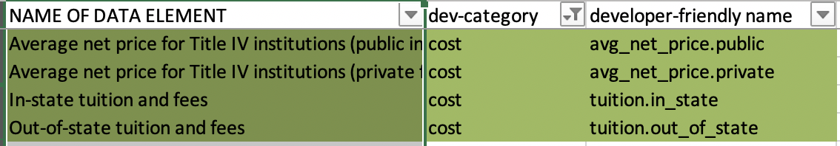
University of California – San Diego
Basic info: table
Name: school.name
Unit ID: root.id
City: school.city
State: school.state
Zipcode: school.zip
No of students: student.size
URL: school.school_url
Degree of Urbanization: school. degree_urbanization
Year: school.institutional_characteristics.level
Online: school.online_only
Admissions:
Overall rate: admissions_rate.overall
SAT/ACT Scores: plotly: bar
Graduation rate:Bar Graph: plotly
Graduation rate: completion. completion_rate_4yr_150nt
Demographic data: Pie chart-Plotly
student.
Map: leaflet
Lat: root.location.lat
Long: root.location.lon
Cost:plotly: line <yr over yr>
Salary:
Earnings. 10
Most Popular Courses: table
academics.
<top5>
Footer

Slide 4









Slide 5
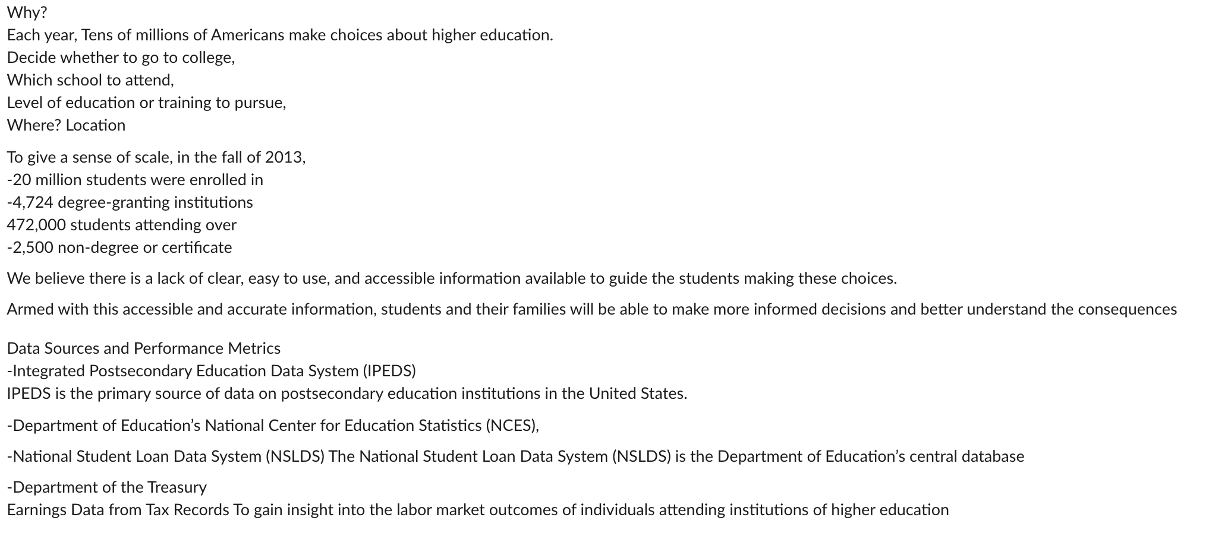

Slide 6
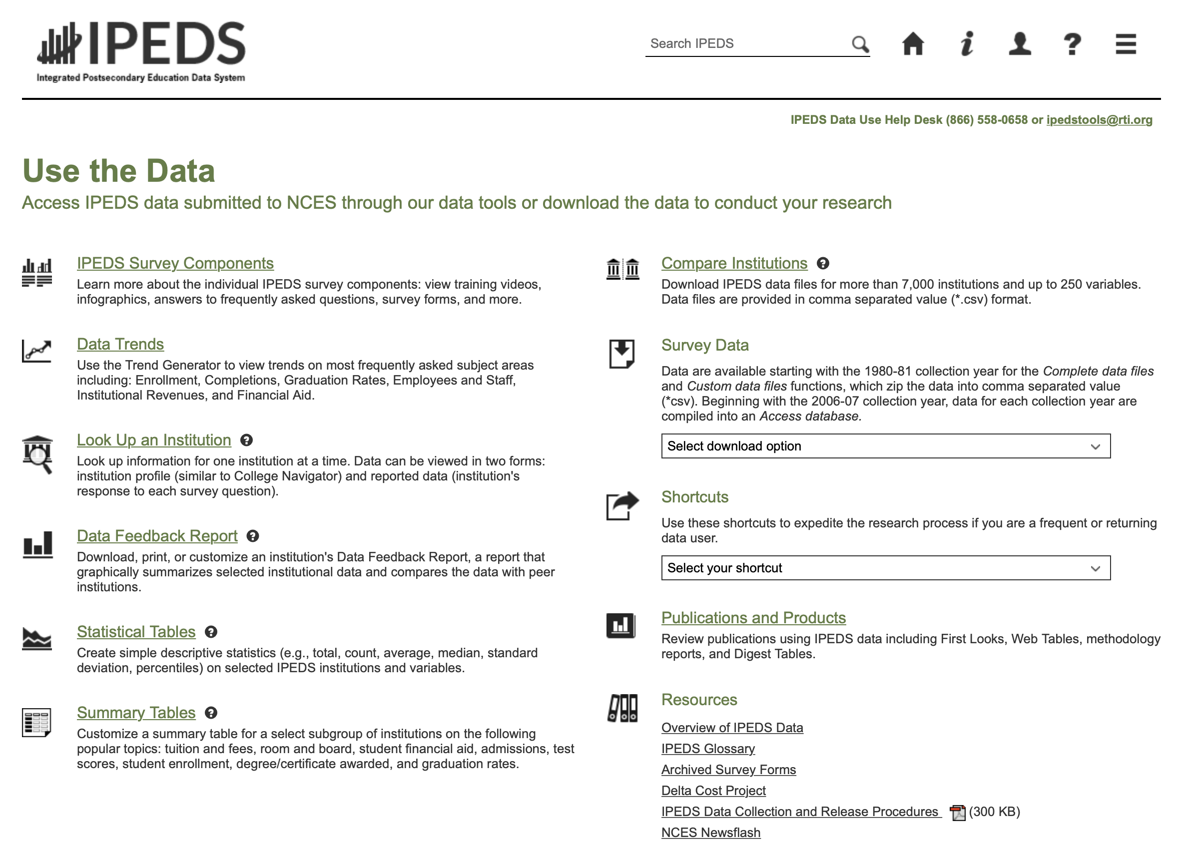
Datasets IPEDS NSLDS Department of Treasury Etc. This page provides more details about the robust data set behind the College Scorecard efforts. You can get information on accessing and understanding the API; download the entire dataset spanning nearly 20 years of data and covering multiple sources including IPEDS, NSLDS, and Department of Treasury; or download smaller data sets, including the data provided on the College Scorecard

Slide 7
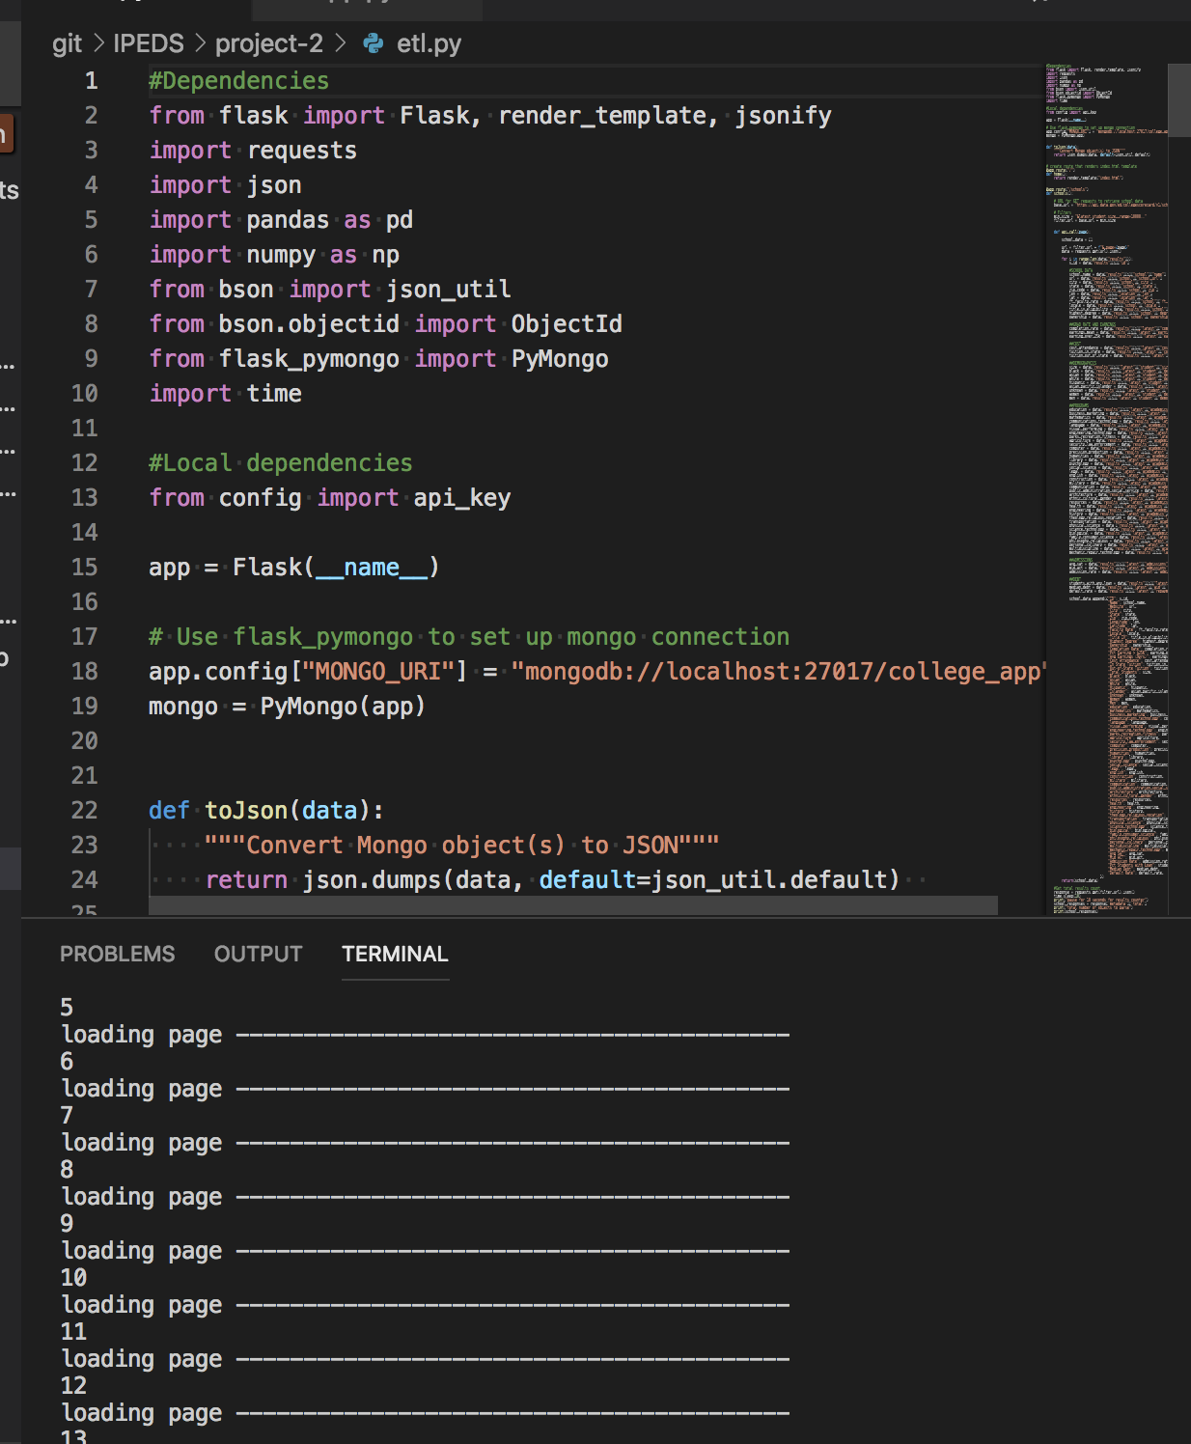

Slide 8
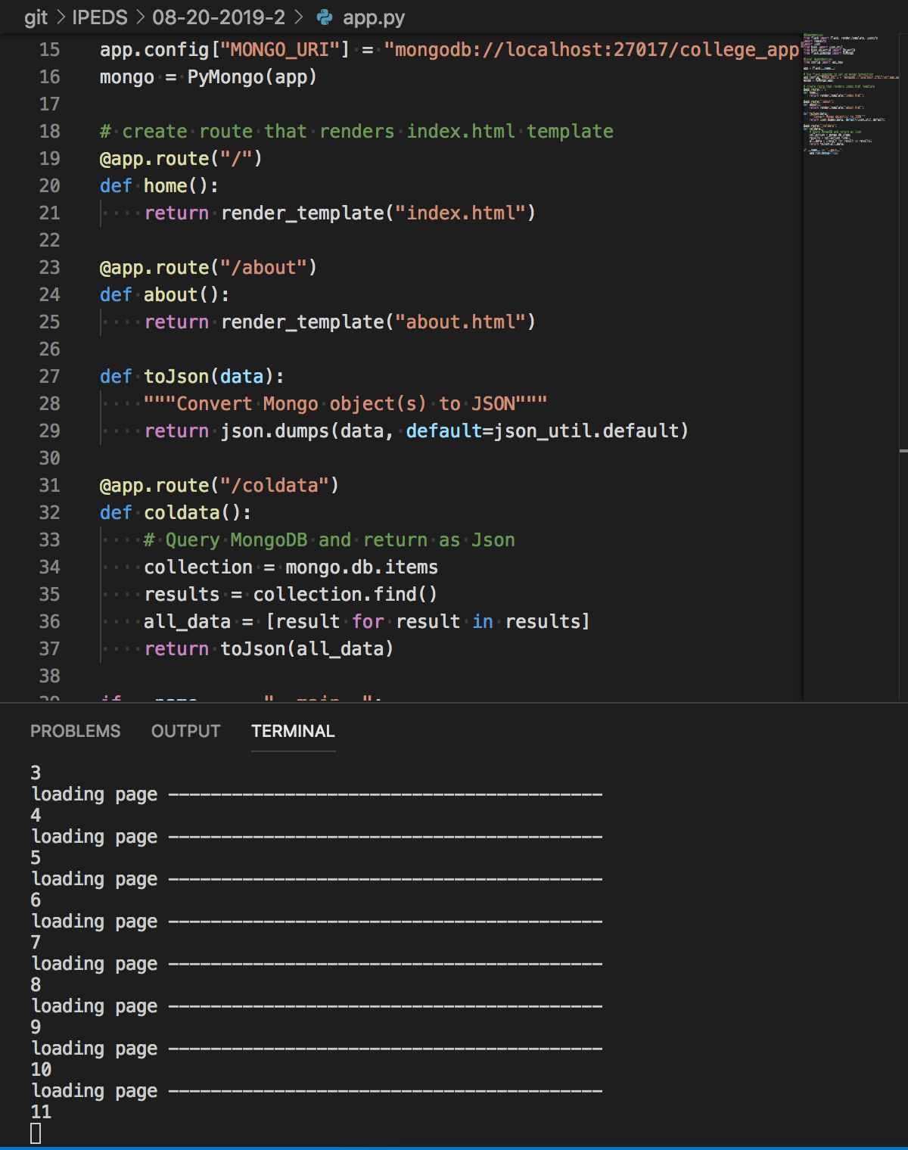
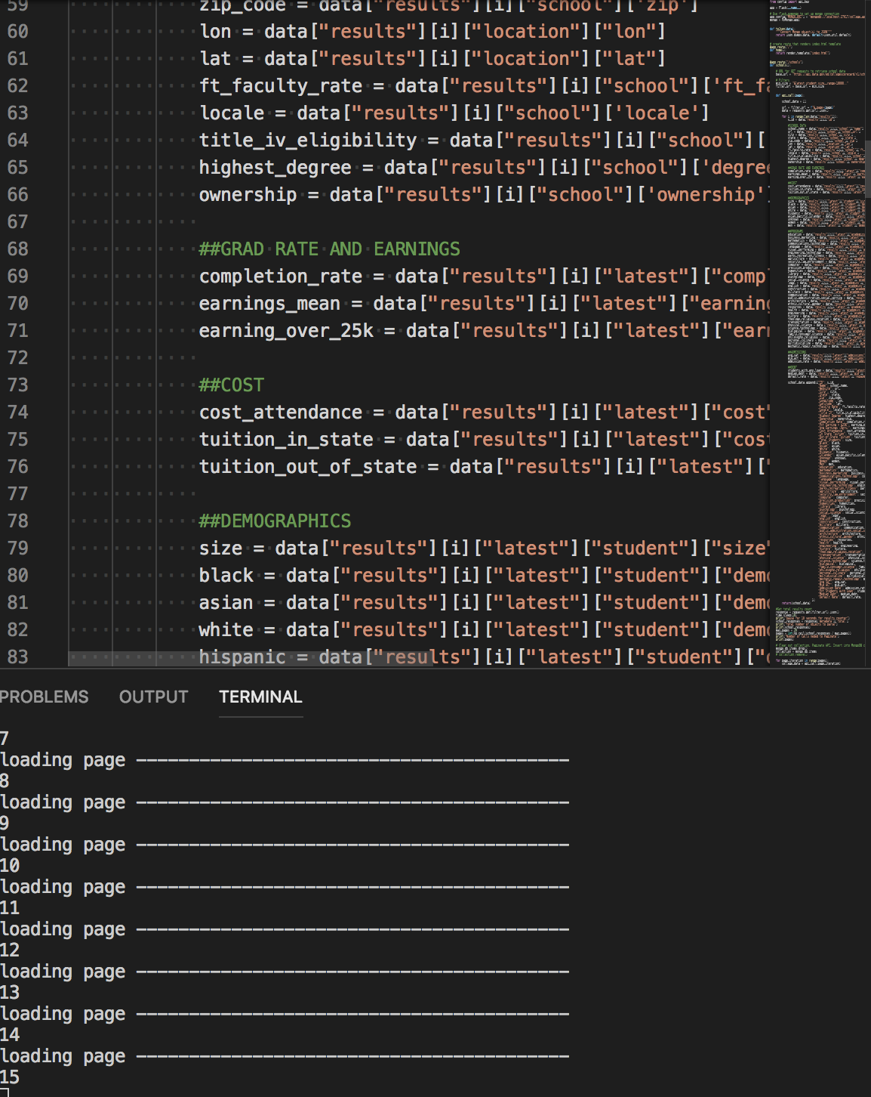

Slide 9
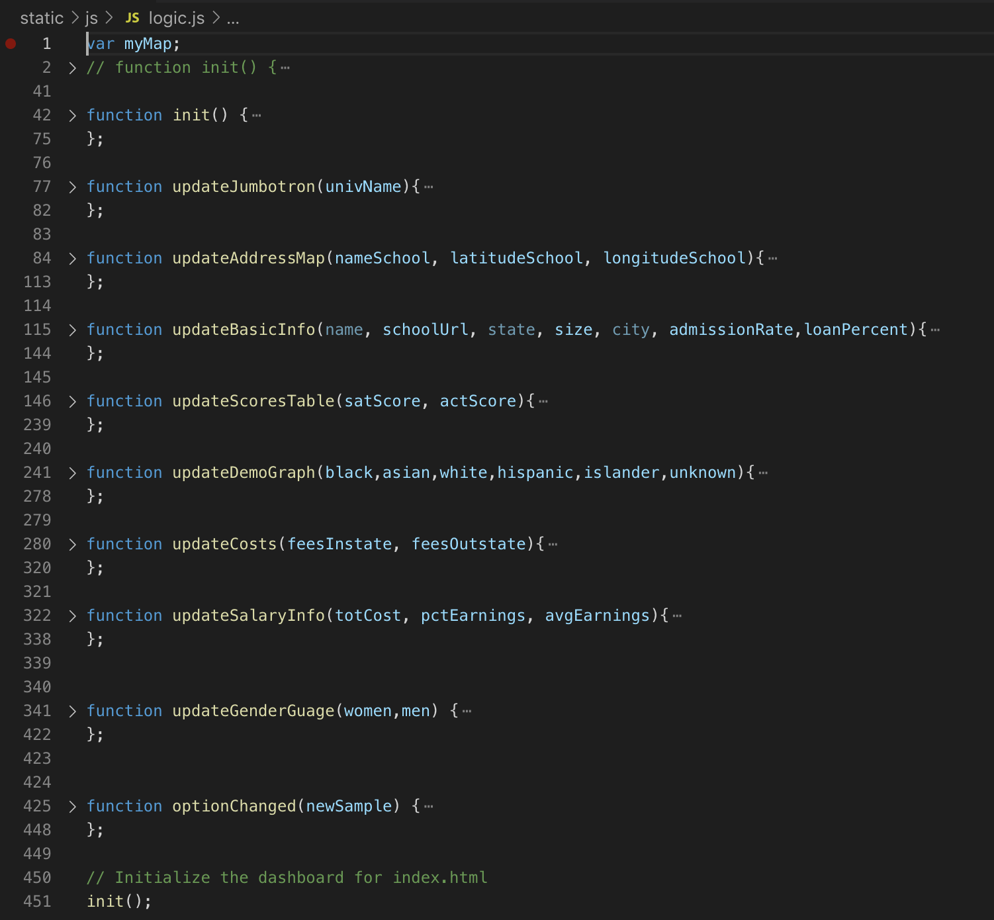

Slide 10


THank you

